Slide 1

E_TUTOR PLATFORM
Your universal hub of knowledge

Slide 2
Team Members (Alphabetically)
Ahmed Mohamed Ateya
Karen Ashraf
Mohamed Abd-Elhakim Abd-Elrahman

Slide 3
About the project
This web site is meant to be a universal hub for exchanging knowledge around the globe, leveraging the fast performance of NodeJS, the responsiveness and snappiness of Single Page Applications built with React, and the flexibility of MongoDB.

Slide 4
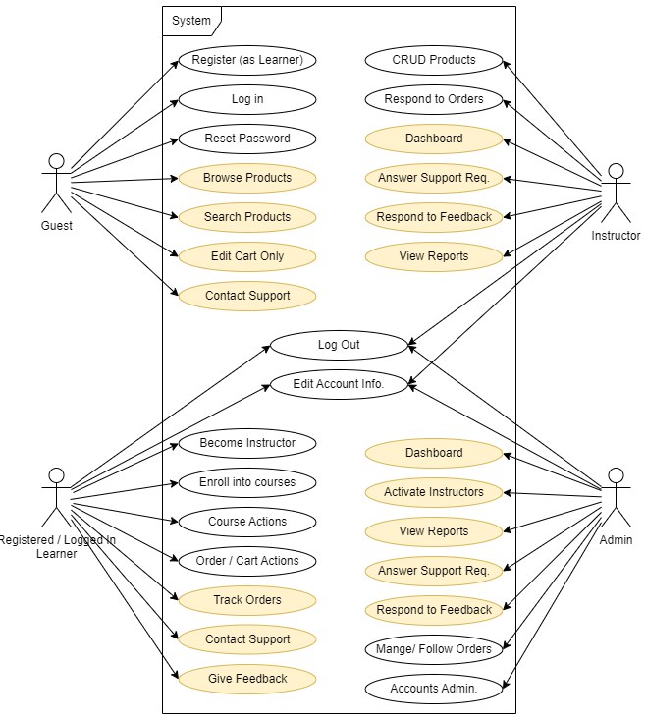

Use Case Diagram
Main Activities
First Priority
Second Priority

Slide 5
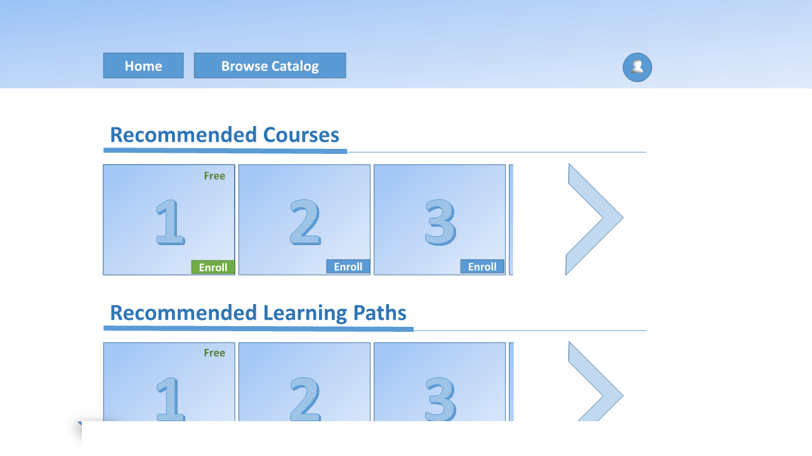
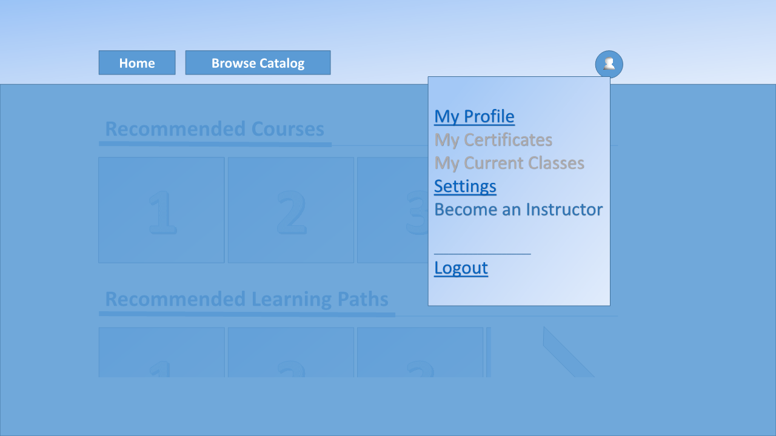
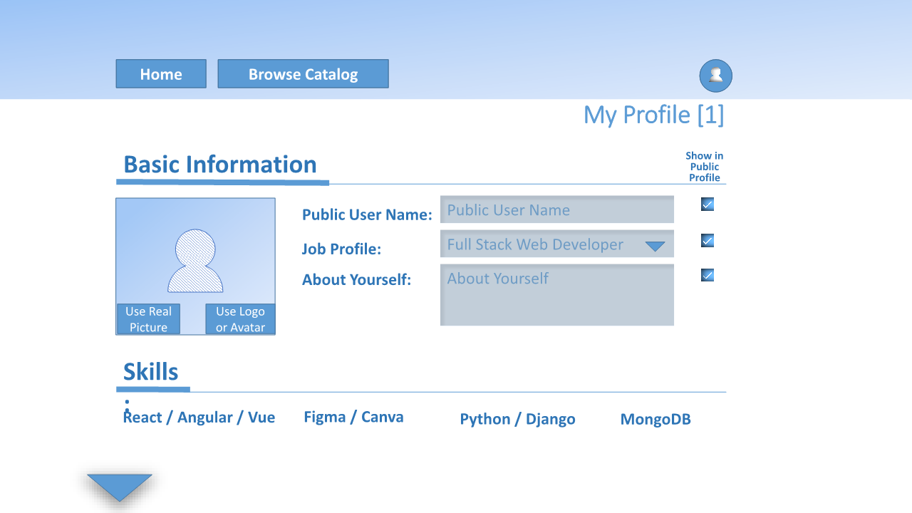
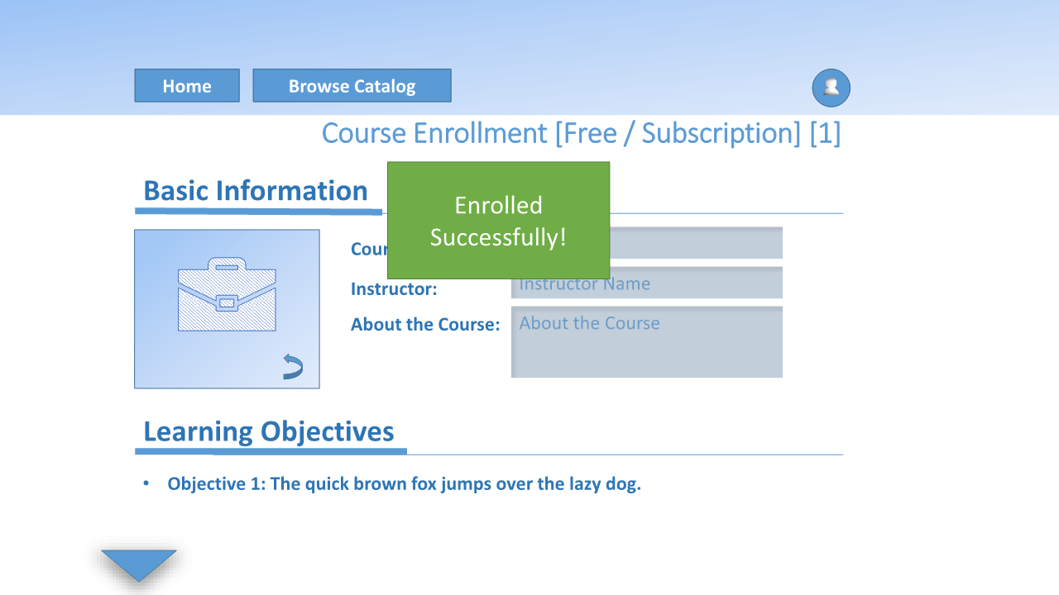
Sample Screenshots From The Low Fidelity Wireframe

Slide 6
Database Structure – Schema 1
user
_ID | email | user_name | first_name | last_name | profile_pic | about_me | user_role | Mobile | Education | Social_Media_Links | Introductory_video
 | srting | srting | srting | srting | srting | string | enum {user , admin , instructor} | string | Array of object [{title :"" , description :" " , time : Date} | Array of object [{title :"" , link :" "}] | srting
 | unique | required | required | required | optional | required | defualt "user" | optinal | optional | optional | optional
 | required |  |  |  |  |  | required
enrolled_courses |  |  |  | progress |  |  |  | category
user_Id | courses_id | Is_complete |  | user_Id | lesson_id | ete |  | Id | name | slug | cover_image
object_id | object_id | Boolean |  | object_id | object_id | Boolean |  | object_id | string | srting | srting
ref User Model | ref Course Model | defualt "false" |  | ref User Model | ref Lesson Model | defualt "false" |  |  | unique | required | optional
required | required | required |  | required | required | required |  |  | required

Slide 7
Database Structure – Schema 2
Courses
_ID | instructor_id | title | description | cover_image | price | discounted_price | not_finished | is_active | is_approved | Introductory_video | category_id | Audience | requirementes | will_teach
 | object_id | srting | srting | srting | Number | Number | Boolean | Boolean | Boolean | srting | [object_id] | [String] | [String] | [String]
 | ref User Model | required | required | optional | required | optional | defualt "true" | defualt "true" | defualt "false" | optional | required | required | required | required
 | required |  |  |  |  |  | required | required | required |  |  | max:8 | max: 8 | max: 8
Lessons
_ID | course_ID | title | objectives | description | duration | cover_image | video | Written summary | order | quiz_link | is_active
 | object_id | srting | srting | srting | Number | srting | srting | srting | Number | CURRENT: Google-form-link | Boolean
 | ref Course Model | required | required | required | required | optional | required | optional | required | TODO: include-in-app | defualt "true"
 | required |  |  |  |  |  |  | pdf || word |  |  | required

Slide 8
Database Structure – Schema 2
reviews |  |  |  |  |  | Cart
title | user_Id | course_id | Rating |  |  | cart_item | user_Id | total_price | discounted_price
object_id | object_id | object_id | Number |  |  | array [{object_id}] | object_id | Number | Number
ref User Model | ref user Model | ref Course Model | min : 1 , max : 5 |  |  | ref Course Model | ref user Model | required | optional
required | required | required | required |  |  | required | required
order
cart_item | user_Id | total_price | is_Paid | payment_at
array [{object_id}] | object_id | Number | Boolean | Date
ref Course Model | ref user Model | required | defualt "true" | required
required | required |  | required

Slide 9
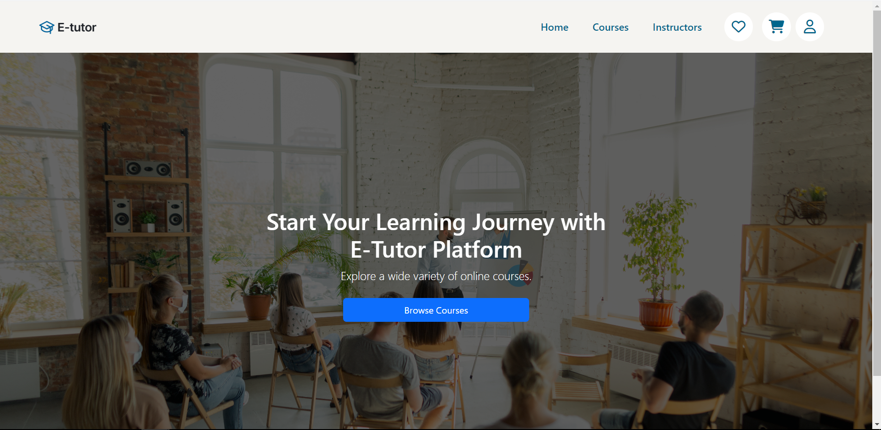
Website Screenshots – 1 (Landing Page)

Slide 10
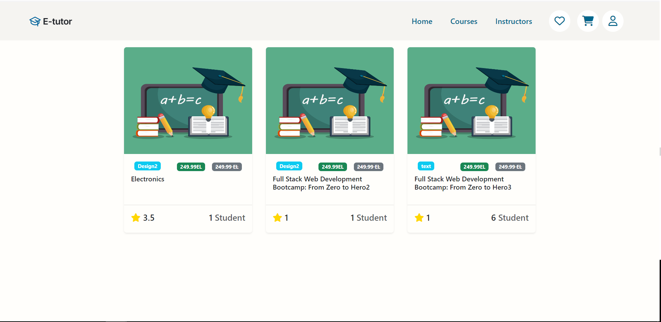
Website Screenshots – 2 (Courses)

Slide 11
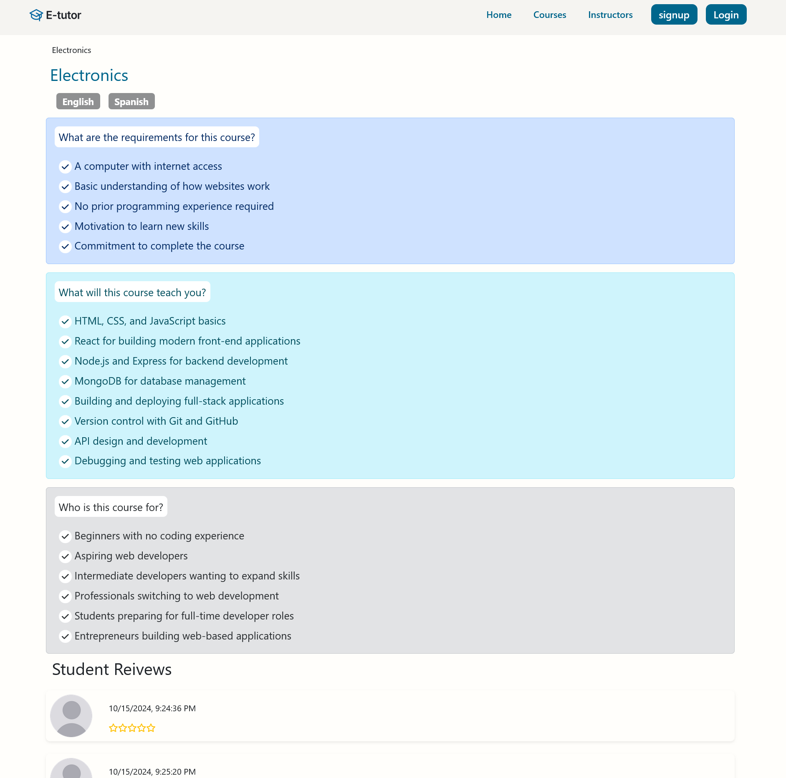
Website Screenshots – 3 (Individual Courses)

Slide 12
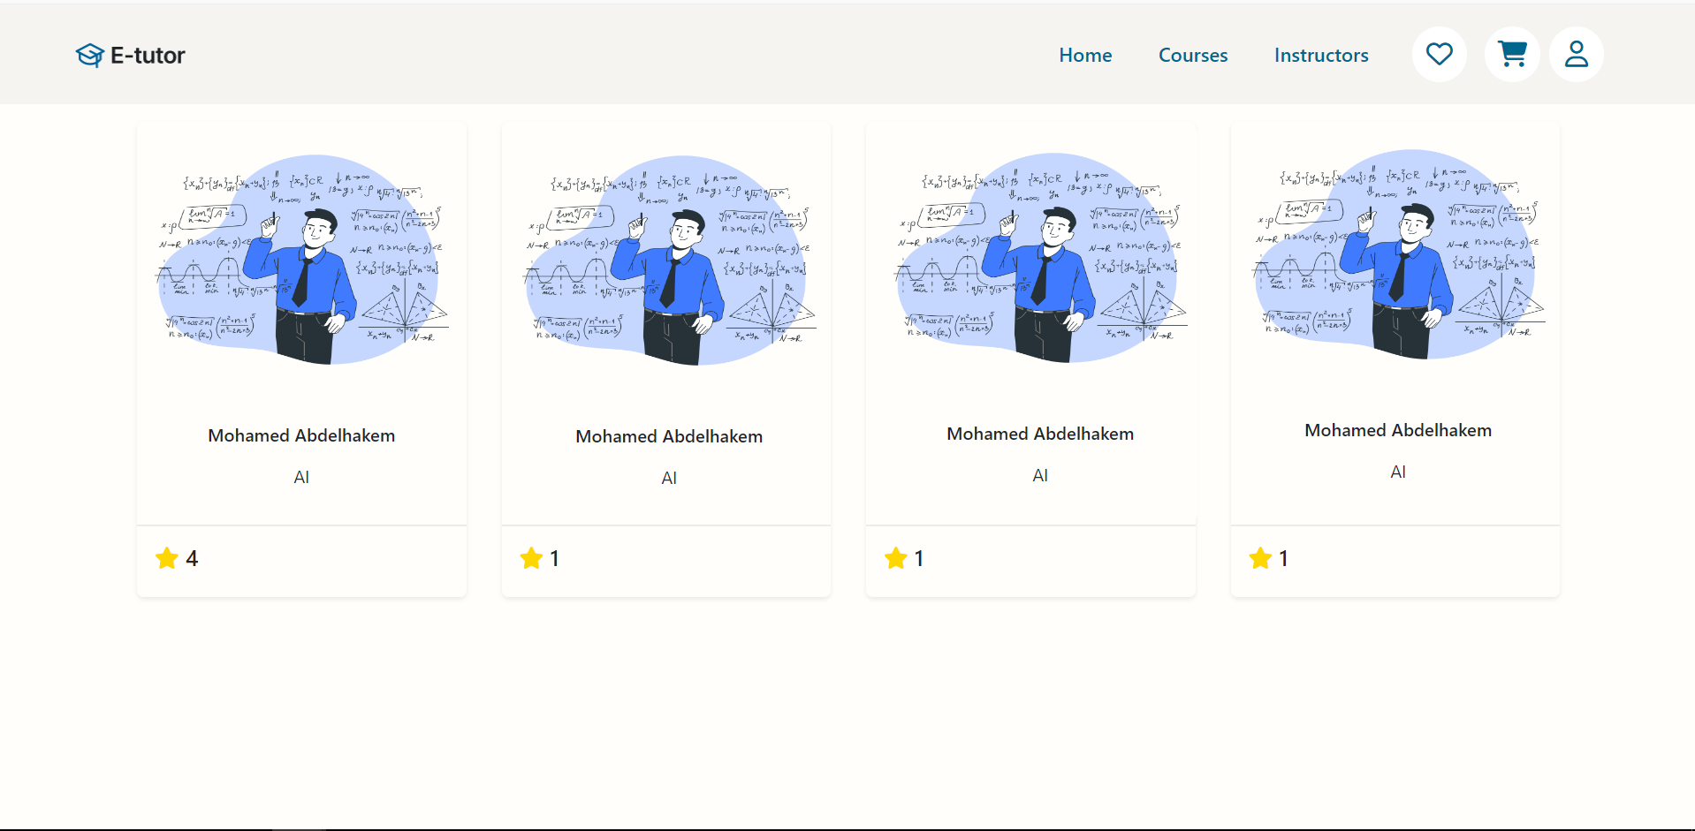
Website Screenshots – 4 (Browse Instructors)

Slide 13
Technologies Used – 1 (Back End)
bcrypt
compression
cookie-parser
cors
dotenv
express
express-async-handler
express-validator
fluent-ffmpeg
jsonwebtoken
mongoose
morgan
multer
nodemailer
sharp
slugify
uuid
validator

Slide 14
Technologies Used – 2 (Front End)
Fontawesome-free
React
axios
bootstrap
formic
framer-motion: ^11.5.4,
js-cookie
jwt-decode
react
react-dom
react-helmet-async
react-router-dom
react-select
react-spinners
sweetalert2
web-vitals
yup

